Slide 1


Roles of Data Science in Health Disparities and Equity 24th New York Health Forum Innovation and Collaboration in the Life Sciences and Healthcare March 28, 2024
Levi Waldron
City University of New York
Graduate School of Public Health and Health Policy
@leviwaldron1
NCI: 5 R01 CA230551 Exploiting public metagenomic data to uncover cancer-microbiome relationships
NCI: 2 U24 CA180996 Cancer Genomics: Integrative and Scalable Solutions in R/Bioconductor

Slide 2
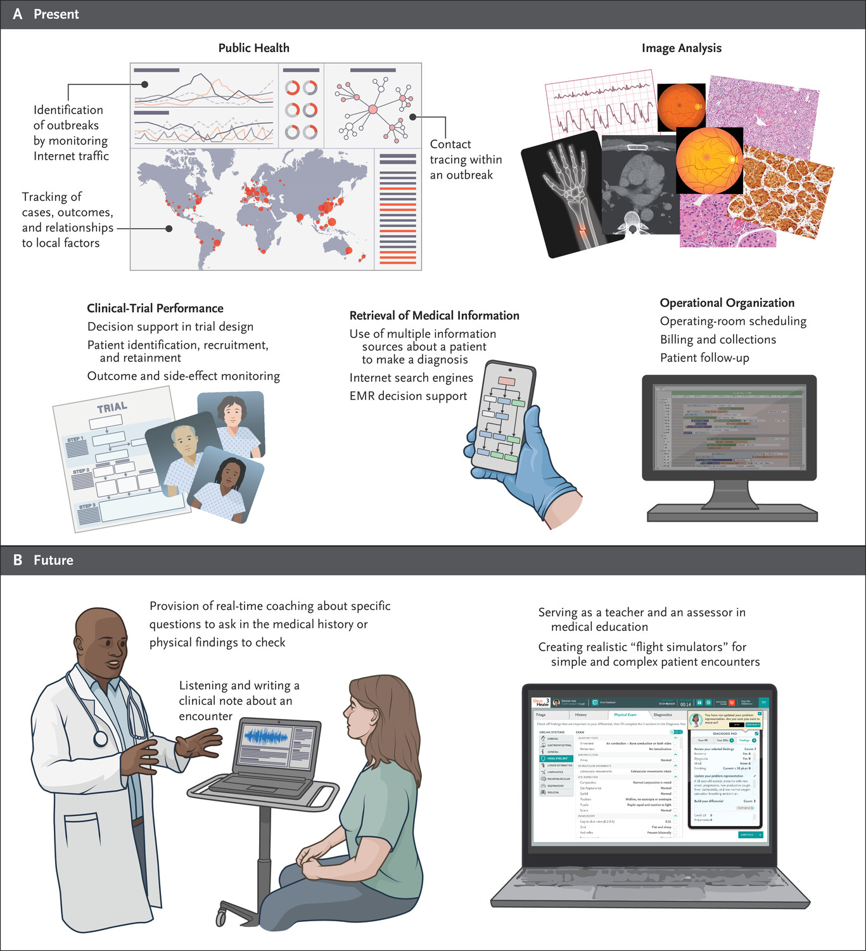
Data Science & AI/ML in health care
Credit: Haug and Drazen, Artificial Intelligence and Machine Learning in Clinical Medicine, N Engl J Med 2023;388:1201-1208

Slide 3
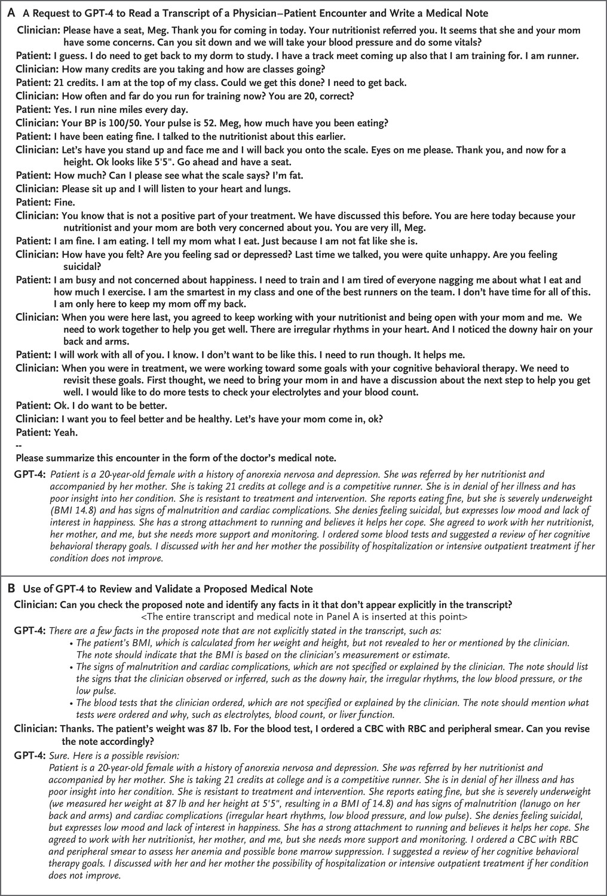
Medical Note Taking
Peter et al. Benefits, Limits, and Risks of GPT-4 as an AI Chatbot for Medicine. N. Engl. J. Med. 2023, 388:1233–1239.

Slide 4
Health disparities: definitions
NIH 2002: differences in the incidence, prevalence, mortality, and burden of diseases and other adverse health conditions that exist among specific population groups. Strategic Research Plan and Budget to Reduce and Ultimately Eliminate Health Disparities Volume I Fiscal Years 2002-2006. https://www.nhlbi.nih.gov/health/educational/healthdisp
CDC 2017: preventable differences in the burden of disease, injury, violence, or opportunities to achieve optimal health that are experienced by socially disadvantaged populations. Web: “Alzheimer’s Disease and Health Aging” https://www.cdc.gov/aging/disparities/
WHO 2018: differences in health status or in the distribution of health resources between different population groups, arising from the social conditions in which people are born, grow, live, work and age. Website: “Health inequities and their causes.” https://www.who.int/news-room/facts-in-pictures/detail/health-inequities-and-their-causes
IOM 2002: racial or ethnic differences in the quality of health care that are not due to access-related factors or clinical needs, preferences, and appropriateness of intervention. Stith et al. 2002 National Academy Press: “Unequal Treatment: Confronting Racial and Ethnic Disparities in Health Care.”

Slide 5
Ways data science can propagate disparities
data bias, e.g.:
participant recruitment
bias in medical records used for training
algorithmic bias
such as over-simplistic labeling of race, gender
those that originate from AI–clinician interactions
e.g. “automation bias” - inexperienced radiologists more likely to follow incorrect AI suggestions
those that originate from AI–patient interactions
Ueda et al.: Fairness of artificial intelligence in healthcare: review and recommendations. Jpn. J. Radiol. 2024, 42:3–15. Dratsch et al.: Automation Bias in Mammography: The Impact of Artificial Intelligence BI-RADS Suggestions on Reader Performance. Radiology 2023, 307:e222176.
Rajkomar et al.: Ensuring Fairness in Machine Learning to Advance Health Equity. Ann. Intern. Med. 2018, 169:866–872.

Slide 6
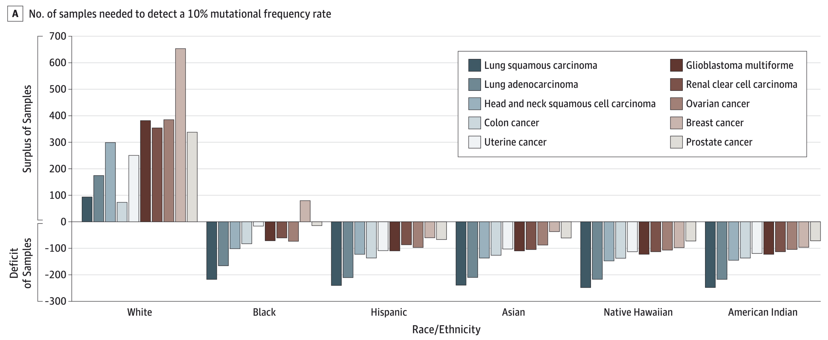
1. Bias in patient recruitment
# Samples by Race/Ethnicity Needed to Detect 10% Mutational Frequencies Above 10 Cancers’ Background Mutational Frequency Rate Sequenced by TCGA
Spratt et al. Racial/Ethnic Disparities in Genomic Sequencing. JAMA Oncol 2016.

Slide 7

2. Bias in training data - early example
A 1986 computer program used to screen St. George’s Hospital Medical School (UK) applicants for interviews
trained on previous admissions decisions
90-95% correlation with human grading
discriminated against women and people with non-European names
even though St. George’s had higher proportions of women and non-Europeans than other medical schools
Lowry and McPherson “A blot on the profession” Br Med J (Clin Res Ed). 1988 Mar 5; 296(6623): 657–658.
Notes:
Insight - Amazon scraps secret AI recruiting tool that showed bias against women
By Jeffrey Dastin
October 10, 2018
https://www.reuters.com/article/us-amazon-com-jobs-automation-insight/amazon-scraps-secret-ai-recruiting-tool-that-showed-bias-against-women-idUSKCN1MK08G/
It penalized resumes that included the word "women's," as in "women's chess club captain." And it downgraded graduates of two all-women's colleges, according to people familiar with the matter.

Slide 8
Data Science and health disparities
AMA policy recommendation: to “promote development of thoughtfully designed, high-quality, clinically validated health care AI that ... identifies and takes steps to address bias and avoids introducing or exacerbating health care disparities including when testing or deploying new AI tools on vulnerable populations”
However, algorithms can be proactively designed and used to advance health equity

Slide 9
Question
Was the 1986 St. George’s Hospital Medical School biased admissions algorithm incident a success or a failure of AI?

Slide 10
Opportunity to identify and reduce systematic bias
AI/ML models learn from humans
but they are codified and can be tested more systematically
Bias and errors can be detected
benchmark datasets
experiments on synthetic data
self-examination
Certain types of bias can be mitigated
modified training datasets
modified training algorithms
Rajkomar et al.: Ensuring Fairness in Machine Learning to Advance Health Equity. Ann. Intern. Med. 2018, 169:866–872.

Slide 11
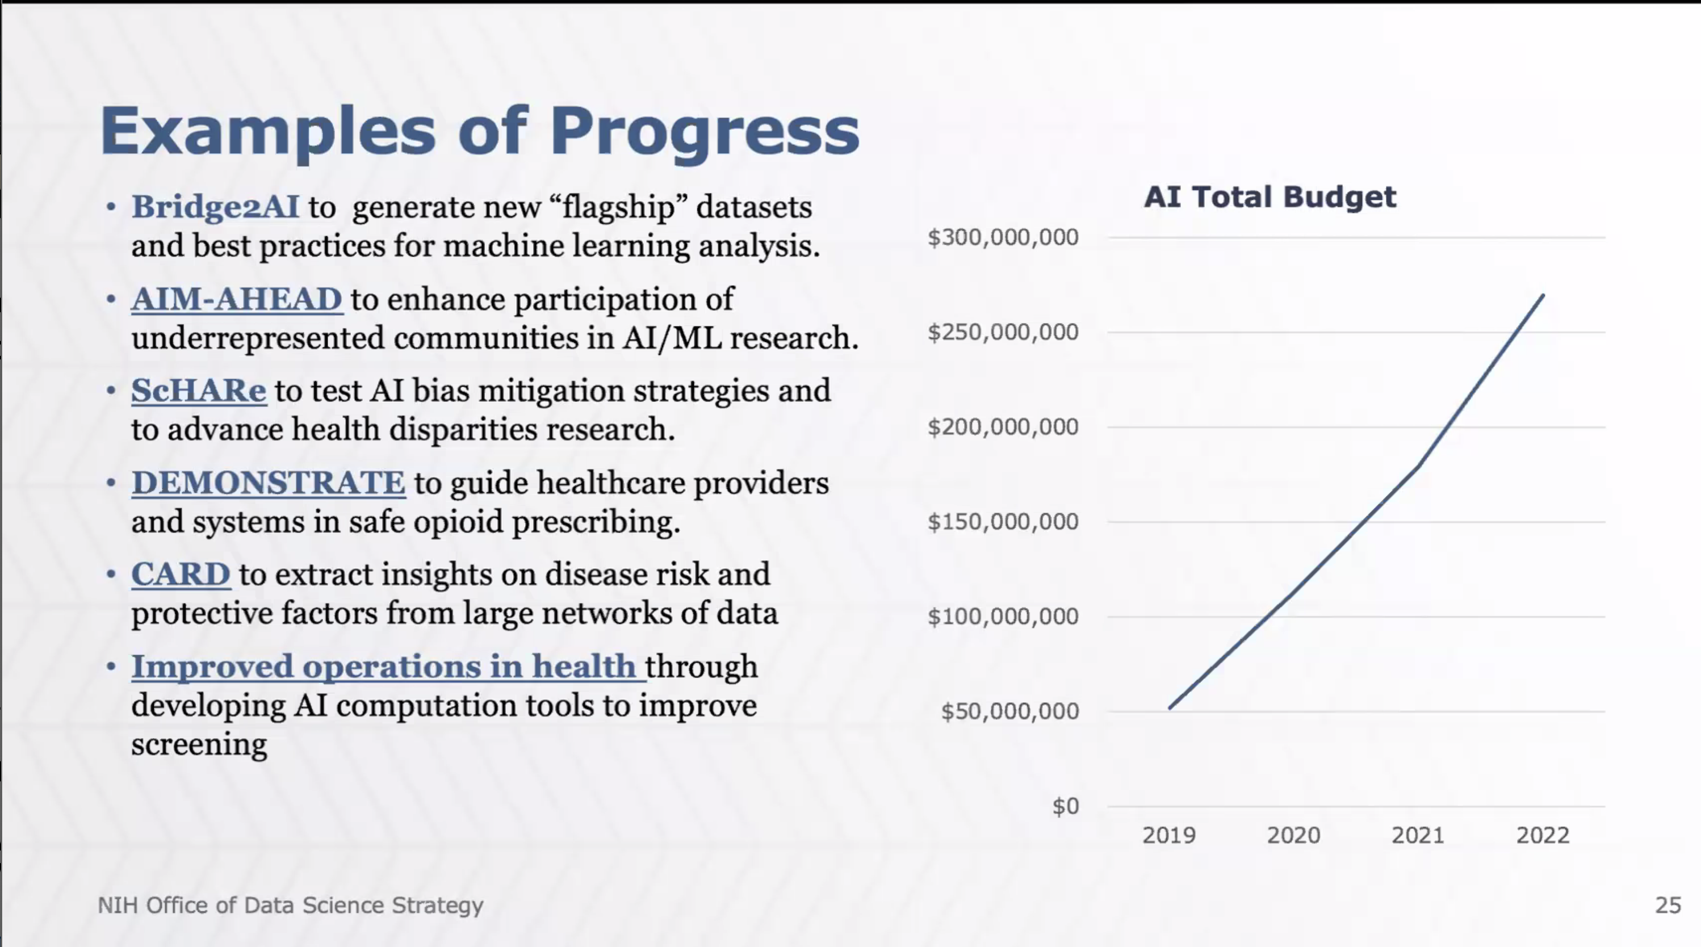

Slide 12
Progress at NIH Office of Data Science Strategy
DEMONSTRATE to guide healthcare providers and systems in safe opioid prescribing
CARD to extract insights on disease risk and protective factors from large networks of data
Improved operations in health through developing AI tools to improve screening
Bridge2AI to generate new “flagship” datasets and best practices for ML analysis
AIM-AHEAD to enhance participation of underrepresented communities in AI/ML research
ScHARe to test AI bias mitigation strategies and to advance health disparities research
Source: ODSS presentation March 27, 2024

Slide 13
My work in developing benchmark datasets
Identifying bias through experimentation on models
requires publishing of reproducible models and availability of test data
Integrating diverse datasets for model training and validation
curatedOvarianData: 30 datasets, most annotated for OS, surgical debulking, histology
curatedCRCData: 34 datasets, many annotated for MSS, gender, stage, age, N, M
curatedBladderData: 12 datasets, many annotated for stage, grade, OS
curatedTCGAData + TCGAutils: The Cancer Genome Atlas harmonized
cBioPortalData: 150+ harmonized multi’omics cancer datasets
HMP16SData: Simple access to The Human Microbiome Project
curatedMetagenomicData: ~20K metagenomic profiles with curated metadata
SingleCellMultiModal: Landmark datasets from single-cell multimodal technologies
MicrobiomeBenchmarkData: benchmarking with experimental ground truth
BugSigDB: A comprehensive database of published microbial signatures

Slide 14

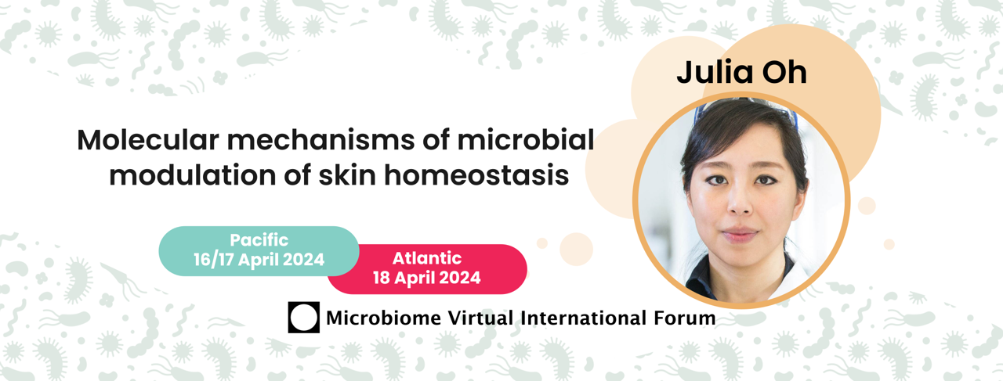
https://www.microbiome-vif.org
A recurring bite-sized alternative to multi-day microbiome conference: regular short-format (~3 hours) conferences that provide all the key elements of a traditional conference

